Slide 1
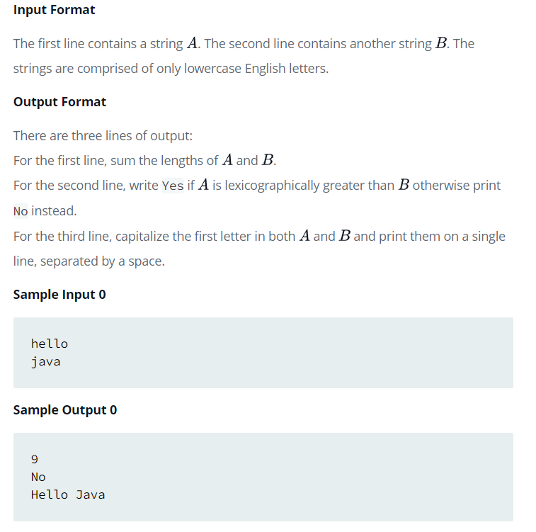
Problem 14th -Java Strings Introduction

Slide 2
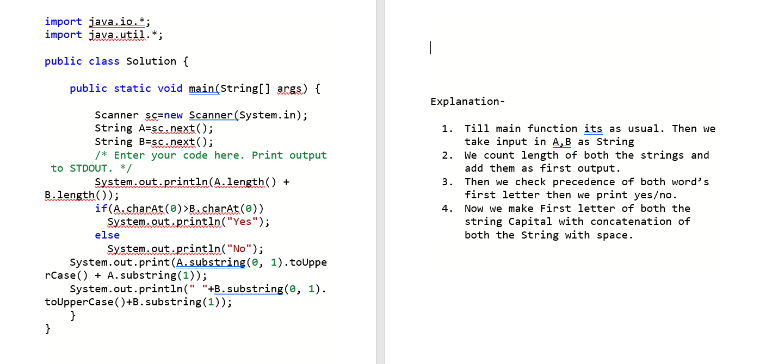
Solution 14th with Explanation-

Slide 3
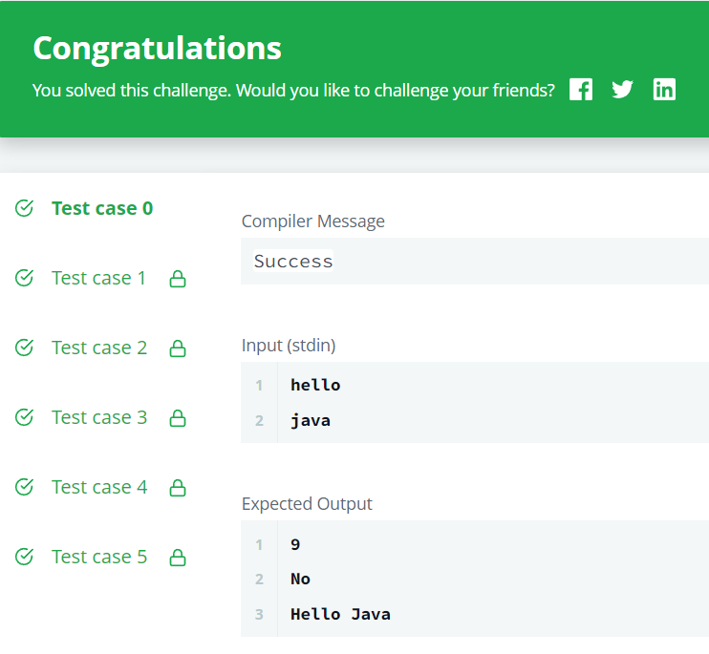
Output 14th -

